Slide 1
CPSC 597 II
PROJECT
Instructor: Dr. Christopher Ryu
DIABETES FORETELLER
BY,
DEEPAK PRASANNA MAYANATTANMY YAGNESWARAN
CWID: 893338442
Mail: dee7@csu.Fullerton.edu

Slide 2
Table of Contents
Background
Motivation
Goals and Objectives
Key Challenges
Key approaches to the problem
Results Produced
Conclusion

Slide 3
Background
Diabetes is a disease in which your blood glucose, or blood sugar, levels are too high.
Over time diabetes can damage the heart, blood vessels, eyes, kidneys and nerves.
There are two common types of diabetes,
In developing countries the disease mainly affects people of working age (40 to 60 years)
Diabetes is not cured by medical surgery.
Type – I | Type - II
Autoimmune disease in which the pancreas can no longer produce insulin | A metabolic disorder in which the body gradually becomes insensitive to the action of insulin
Key influencers include – Age, Obesity, Lack of fitness | Commonly occurs after pregnancy

Slide 4
Motivation
Diabetes produces detrimental health effects to the human beings
There are no precise symptoms for the disease
Most often diabetes will be diagnosed at the late stages
Producing no remedy to the medication
To solve these problems,
I have developed an android application named ‘Diabetes Foreteller’
Diabetes Foreteller helps the user to assess his/her probability of having diabetes by analyzing the various symptoms of diabetes and the lifestyle of the user.
Suggesting the probability of having diabetes to the user,
Creates an awareness
Cautions him about the detrimental health effects caused by the diabetes.
In addition to this, my application also recommends the preventive measures for avoiding the diabetes in one’s lifetime.

Slide 5
Goals and Objectives
Goal:
To build an android application that estimates the probability of diabetes for a person in his lifetime.
Objectives:
Research and collect all the symptoms related to diabetes
Build a machine learning model that generates the probability of diabetes with respect to the user data.
Convert the machine learning model as RESTful web service and deploy the model in cloud environment
Build an android application that helps the user to access their probability of diabetes

Slide 6
Key Challenges
Collecting key diabetic symptoms
Collecting diabetes dataset relevant to the symptoms
Building a machine learning model with a great accuracy
Building an easy user interface that can be accessed by all type of users
Connecting the application with the backend (RESTful Web Service)

Slide 7
Key Approaches
This section is divided into various sub-topics, they are
Diabetes dataset
Study related to the dataset
Machine Learning Model
Results achieved from Machine Learning Model
Diabetes Foreteller RESTful Web service
Diabetes Foreteller android application

Slide 8
Key Approaches
Diabetes dataset
I have used PIMA Indians Diabetes Database provided by the UCI Machine Learning Repository (famous repository for machine learning data sets).
Why PIMA Indians Dataset for diabetes?
Hard to collect real time diabetes data
PIMA is a top class institute
PIMA diabetes dataset includes proven features that influence diabetes
Accurate data (reliable)

Slide 9
Key Approaches
About the dataset
The dataset includes data from 768 women with 8 characteristics, in particular:
Number of times pregnant
Plasma glucose concentration a 2 hours in an oral glucose tolerance test
Diastolic blood pressure (mm Hg)
Triceps skin fold thickness (mm)
2-Hour serum insulin (mu U/ml)
Body mass index (weight in kg/(height in m)^2)
Diabetes pedigree function
Age (years)

Slide 10
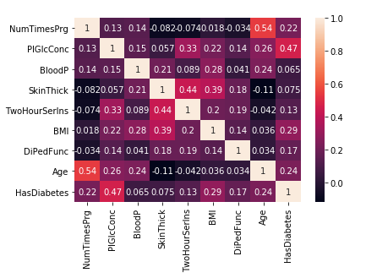
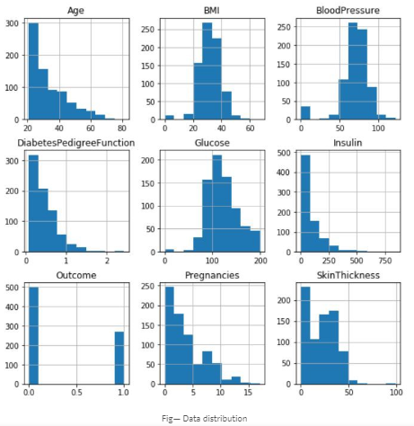
Key Approaches
Study related to the dataset
Heatmap
Histogram

Slide 11
Key Approaches
Study related to the data
Based on Heatmap,
The greater the age or the BMI of a patient is, the greater probabilities are the patient can develop diabetes.
Age and Pregnancy seems to have high correlation with each other.
Based on Histogram, the distribution of data is very uneven, need to standardize the dataset for faster training of machine learning model.
Average Insulin value102.5 (mu U/ml) for a healthy person
The Skin Thickness for most diabetic persons is 32.0 (mm)
Average Insulin value169.5 (mu U/ml) for a diabetic person
Blood pressure for diabetic persons always ranges above 74.5 (mm Hg)
Average Glucose value107.9 for a healthy person and 140.0 for a diabetic person

Slide 12
Key Approaches
Machine Learning Model
Rather than relying on popular machine learning frameworks such as Keras, TensorFlow, I wanted to challenge myself by building a neural network completely on my own.
Based on my experience with Deep Learning, I have followed a methodology I learnt from ‘Deep Learning Specialization’ by Andrew Ng.
METHODOLOGY FOLLOWED:
1. Initialize parameters / Define hyperparameters
2. Loop for number of iterations:
a. Forward propagation
b. Compute cost function
c. Backward propagation
d. Update parameters (using parameters, and grads from backprop)
4. Use trained parameters to predict labels

Slide 13
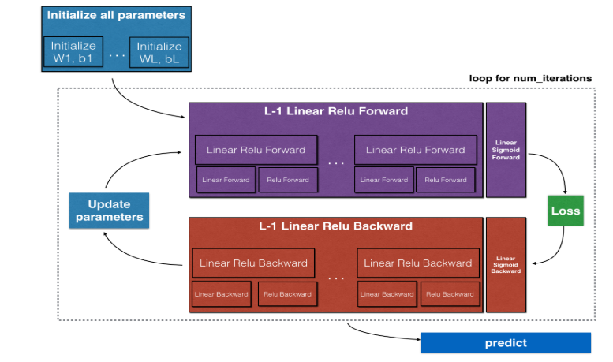
Key Approaches
Machine Learning Model – Methodology followed

Slide 14
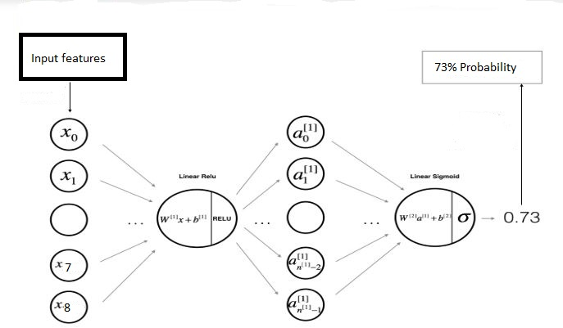
Key Approaches
Machine Learning Model - Architecture

Slide 15
Key Approaches
Machine Learning Model
KEY ASPECTS OF MY MODEL:
I have built a deep neural network with 6 layers.
Hence, my model has 5 hidden layers and one output layer
My model is mentioned as ,
[LINEAR -> RELU] × (L-1) -> LINEAR -> SIGMOID
RELU activation function or Rectifier:
I have used RELU activation function for removing the negative values
RELU activation function is used on 5 hidden layers as the activation function
RELU activation is given by,
R(Z) = max(0,Z)
Sigmoid Function:
At the output layer (layer 6), I have used Sigmoid function as the activation function for getting the probability values at the output.

Slide 16
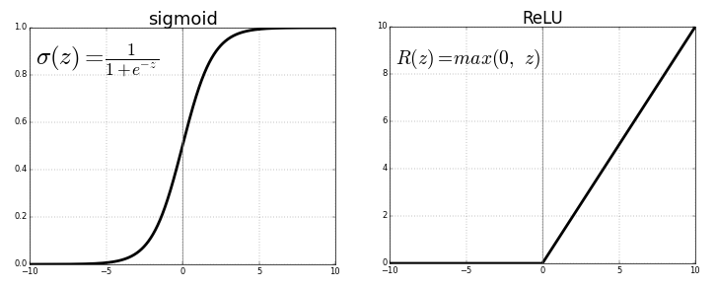
Key Approaches
Machine Learning Model – Activation functions

Slide 17
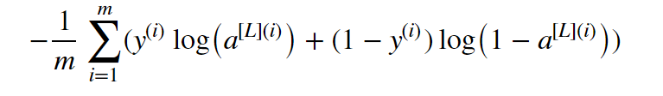
Key Approaches
Machine Learning Model
Model Training details:
1. Learning Rate = 0.0075
2. Num of iterations = 8000
3. Regularization = ‘Dropout Regularization’
4. Early stopping = True
5. Optimization = ‘Stochastic Gradient Descent’
6. Cost function used: Entropy loss function

Slide 18
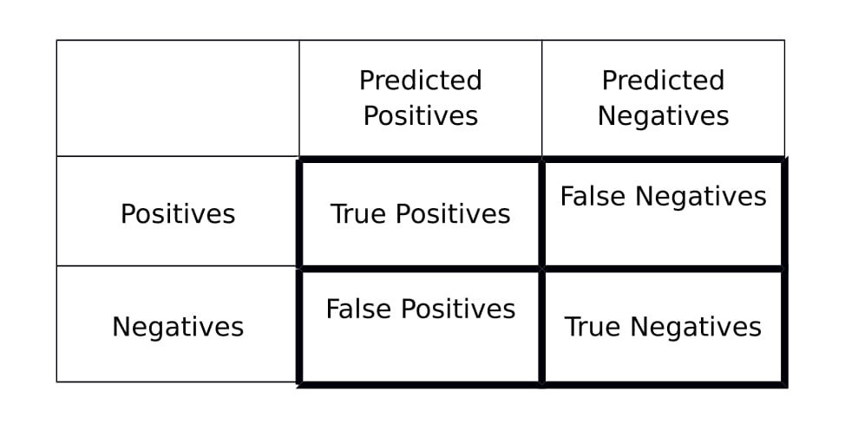
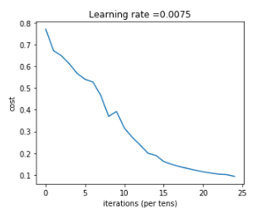
Key Approaches
Machine Learning Model – Results Achieved
Accuracy: 86%
F1 Score (training set): 1.0
F1 Score (test set): 0.79
What is F1 score?

Slide 19
Key Approaches
Diabetes Foreteller RESTful Web Service
To fuse my machine learning model with an android application, I have adapted the following practices,
Converted my machine learning model as RESTful Web Service using Flask
Deployed the REST with Amazon API Gateway and AWS Lambda.
This API acts as the backend for my android application.

Slide 20
Key Approaches
Diabetes Foreteller Android Application
Developed an android user interface which helps the users to calculate his probability of diabetes.
If a user is already an diabetic patient, he can expect a higher probability value
If a user is healthy, he can expect an low probability value (<40%)

Slide 21
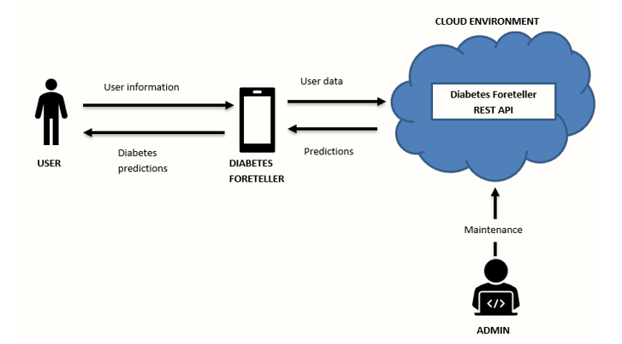
Key Approaches
Diabetes Foreteller Android Application
Context Diagram

Slide 22
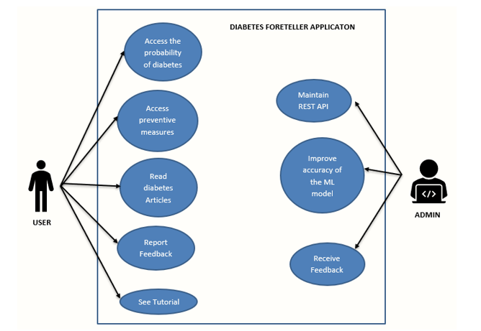
Key Approaches
Diabetes Foreteller Android Application – Use case
Use case diagram

Slide 23
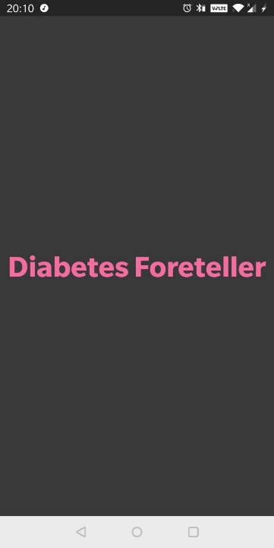
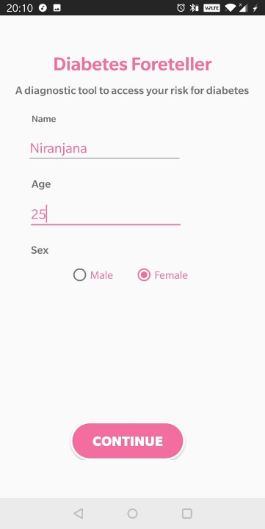
Results Produced
Screenshots of Diabetes Foreteller
Step 1:
Step 2:

Slide 24
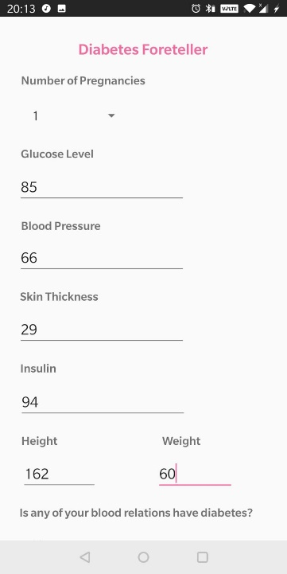
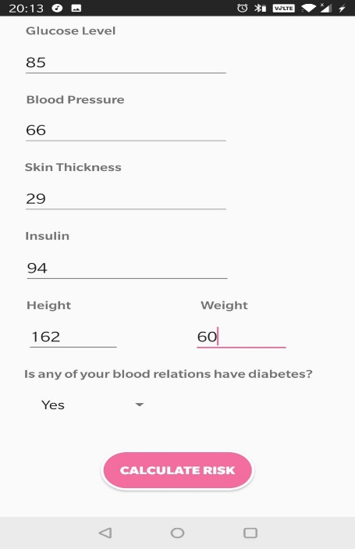
Results Produced
Screenshots of Diabetes Foreteller
Step 3:
Step 4:

Slide 25
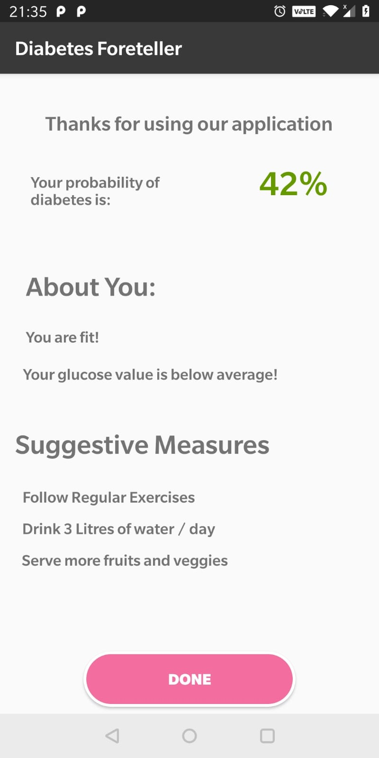
Results Produced
Screenshots of Diabetes Foreteller
The user has entered all her biometric details
The output is the probability of diabetes, which is 42% for this user.
Based on the biometric details the user has entered and probability of diabetes, few suggestive measures has been recommended to the user.

Slide 26
Conclusion
In this project,
1. Key Goals has been achieved
2. Built a machine learning model with 86% accuracy.
3. Built a RESTful API with Flask framework
4. Built android application for the end users
All the goals and objectives has been achieved!
Future Outcomes:
Convert the supervised machine learning model into Reinforcement model for collecting more data
Built a website which is portable for all the devices
Improve the accuracy to 99%

Slide 27
References
[1] Analysis and prediction of diabetes diseases using machine learning algorithm: Ensemble approach.
<https://pdfs.semanticscholar.org/f5e0/290d66e0fc12ba409fda0fc2a2c6a7c1066e.pdf>
[2] Gradient Boosting
< https://en.wikipedia.org/wiki/Gradient_boosting>
[3] Deep Learning Specialization
< https://www.coursera.org/specializations/deep-learning>
[4] INTRODUCTION TO MACHINE LEARNING
< http://robotics.stanford.edu/~nilsson/MLBOOK.pdf>
[5] MVP Architecture for Android Applications
<https://medium.com/@arifnadeem7/mvp-architecture-for-android-applications-3a403355b345>

